Slide 1
Carcharhinid Analysis: Shark Groups
Chris, Spencer, Parker

Slide 2
Average Food Eaten per Instance of top 3 food combos (Black Tips)

Slide 3
Average Food Eaten per Instance of top 3 food combos (Ross & Chandler)

Slide 4
Average Food Eaten per Instance of top 3 food combos (Gray Reef)

Slide 5
Average Eaten per Instance for Ross and Chandler (Top 3 food combos)

Slide 6
Total Eaten Ross and Chandler (Top 3 food combos)
Totals:
Ross - 1017
Chandler - 877

Slide 7
Garlic

Slide 8
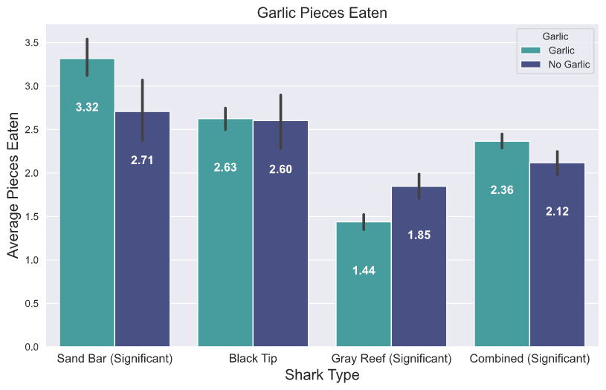

Slide 9
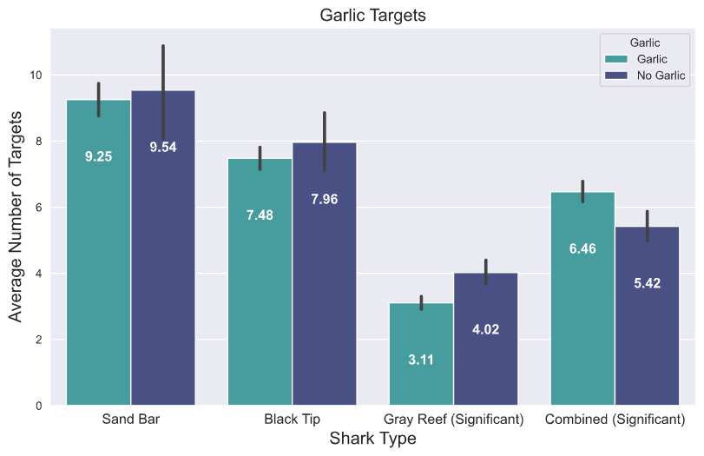

Slide 10
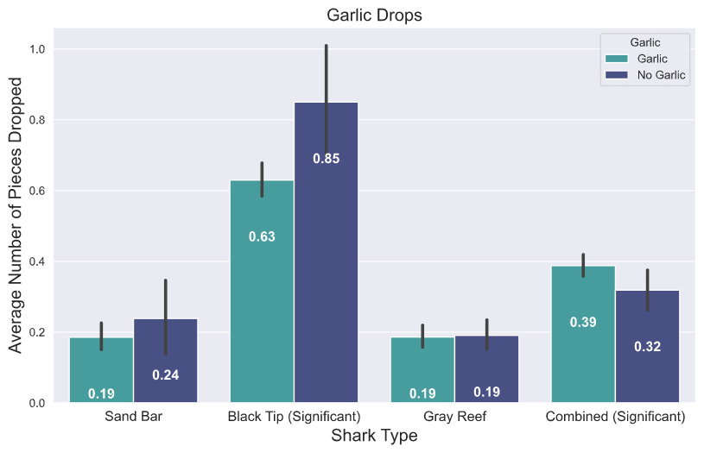

Slide 11
Mazuri Vitamins

Slide 12
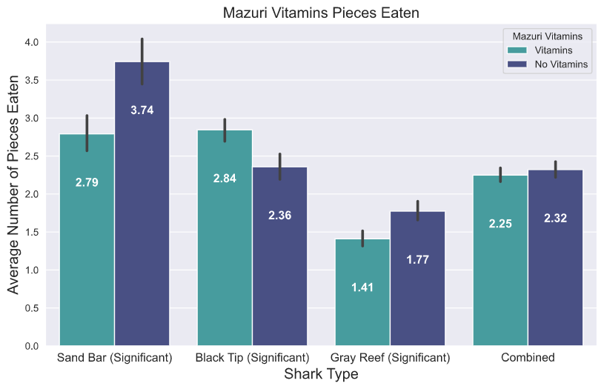

Slide 13
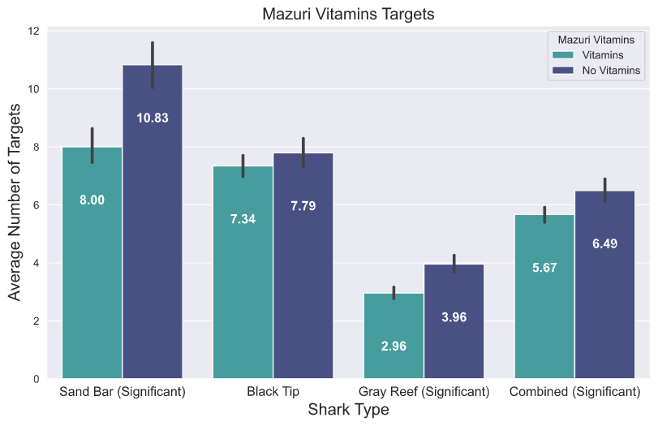

Slide 14
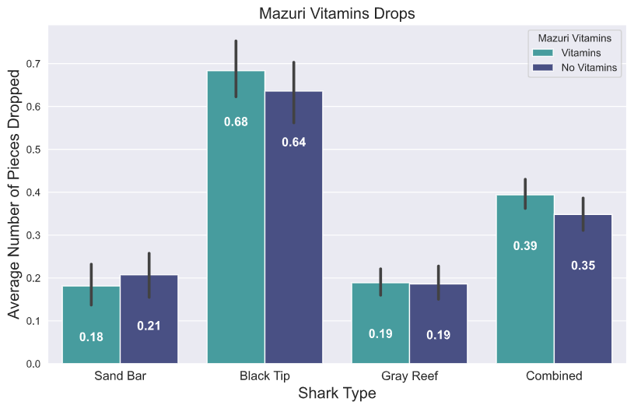

Slide 15
Group Feeding

Slide 16
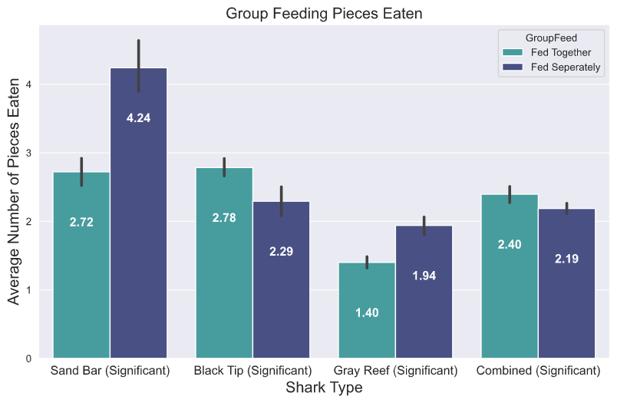

Slide 17
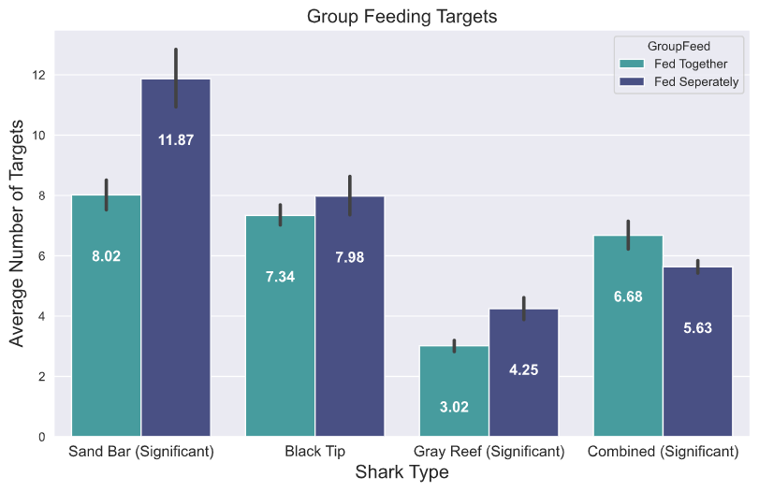

Slide 18
